Slide 1
Hardware Acceleration of Matrix Multiplication using Systolic Arrays
MGM Manjunath 2210110387 Revanth Kavuri 2210110504 P Aishwarya Reddy 2210110669

Slide 2
Introduction
Matrix multiplication is essential in machine learning, computer vision, and scientific computing.
Traditional processors struggle with performance as matrix sizes grow.
Systolic arrays offer a parallel hardware approach with efficient data movement.
This work presents a systolic array design that improves speed, scalability, and energy efficiency for matrix multiplication.

Slide 3
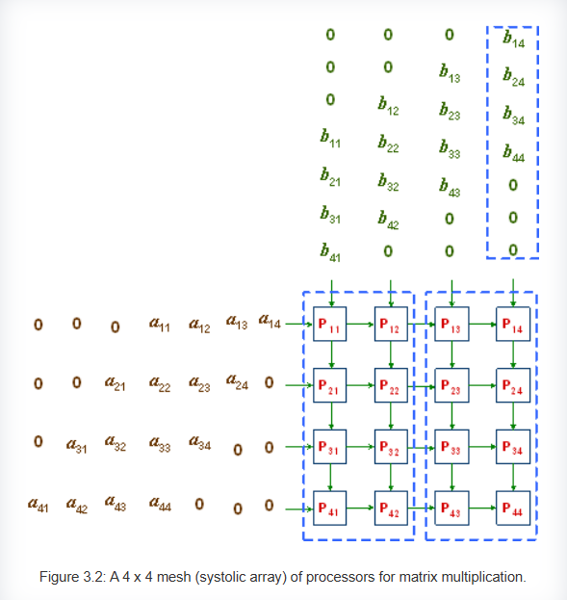
Working Method of Systolic Arrays
Reference - https://ecelabs.njit.edu/ece459/lab3.php

Slide 4
Verilog Code of 8x8 Matrix Multiplication using Systolic Arrays
Top Module -
module topmodule (clk, reset, a1, a2, a3, a4, a5, a6, a7, a8, b1, b2, b3, b4, b5, b6, b7, b8, c1, c2, c3, c4, c5, c6, c7, c8, c9, c10, c11, c12, c13, c14, c15, c16, c17, c18, c19, c20, c21, c22, c23, c24, c25, c26, c27, c28, c29, c30, c31, c32, c33, c34, c35, c36, c37, c38, c39, c40, c41, c42, c43, c44, c45, c46, c47, c48, c49, c50, c51, c52, c53, c54, c55, c56, c57, c58, c59, c60, c61, c62, c63, c64);
parameter size=8; input wire clk,reset; input wire [size-1:0] a1,a2,a3,a4,a5,a6,a7,a8,b1,b2,b3,b4,b5,b6,b7,b8; output wire [2*size:0] c1, c2, c3, c4, c5, c6, c7, c8, c9, c10, c11, c12, c13, c14, c15, c16, c17, c18, c19, c20, c21, c22, c23, c24, c25, c26, c27, c28, c29, c30, c31, c32, c33, c34, c35, c36, c37, c38, c39, c40, c41, c42, c43, c44, c45, c46, c47, c48, c49, c50, c51, c52, c53, c54, c55, c56, c57, c58, c59, c60, c61, c62, c63, c64;
// Horizontal wires (a) wire [size-1:0] a12, a23, a34, a45, a56, a67, a78, a910, a1011, a1112, a1213, a1314, a1415, a1516, a1718, a1819, a1920, a2021, a2122, a2223, a2324, a2526, a2627, a2728, a2829, a2930, a3031, a3132, a3334, a3435, a3536, a3637, a3738, a3839, a3940, a4142, a4243, a4344, a4445, a4546, a4647, a4748, a4950, a5051, a5152, a5253, a5354, a5455,a5556,a5758,a5859,a5960,a6061,a6162,a6263,a6364;
// Vertical wires (b) wire [size-1:0] b19, b210, b311, b412, b513, b614, b715, b816, b917, b1018, b1119, b1220, b1321, b1422, b1523, b1624, b1725, b1826, b1927, b2028, b2129, b2230, b2331, b2432, b2533, b2634, b2735, b2836, b2937, b3038, b3139, b3240, b3341, b3442, b3543, b3644, b3745, b3846, b3947, b4048, b4149, b4250, b4351, b4452, b4553, b4654, b4755, b4856, b4957, b5058, b5159, b5260, b5361, b5462, b5563, b5664;

Slide 5
// Row 1 block pe1(.clk(clk),.reset(reset),.in_a(a1),.in_b(b1),.out_a(a12),.out_b(b19),.out_c(c1)); block pe2(.clk(clk),.reset(reset),.in_a(a12),.in_b(b2),.out_a(a23),.out_b(b210),.out_c(c2)); block pe3(.clk(clk),.reset(reset),.in_a(a23),.in_b(b3),.out_a(a34),.out_b(b311),.out_c(c3)); block pe4(.clk(clk),.reset(reset),.in_a(a34),.in_b(b4),.out_a(a45),.out_b(b412),.out_c(c4)); block pe5(.clk(clk),.reset(reset),.in_a(a45),.in_b(b5),.out_a(a56),.out_b(b513),.out_c(c5)); block pe6(.clk(clk),.reset(reset),.in_a(a56),.in_b(b6),.out_a(a67),.out_b(b614),.out_c(c6)); block pe7(.clk(clk),.reset(reset),.in_a(a67),.in_b(b7),.out_a(a78),.out_b(b715),.out_c(c7)); block pe8(.clk(clk),.reset(reset),.in_a(a78),.in_b(b8),.out_a(),.out_b(b816),.out_c(c8));
// Row 2 block pe9(.clk(clk),.reset(reset),.in_a(a2),.in_b(b19),.out_a(a910),.out_b(b917),.out_c(c9)); block pe10(.clk(clk),.reset(reset),.in_a(a910),.in_b(b210),.out_a(a1011),.out_b(b1018),.out_c(c10)); block pe11(.clk(clk),.reset(reset),.in_a(a1011),.in_b(b311),.out_a(a1112),.out_b(b1119),.out_c(c11)); block pe12(.clk(clk),.reset(reset),.in_a(a1112),.in_b(b412),.out_a(a1213),.out_b(b1220),.out_c(c12)); block pe13(.clk(clk),.reset(reset),.in_a(a1213),.in_b(b513),.out_a(a1314),.out_b(b1321),.out_c(c13)); block pe14(.clk(clk),.reset(reset),.in_a(a1314),.in_b(b614),.out_a(a1415),.out_b(b1422),.out_c(c14)); block pe15(.clk(clk),.reset(reset),.in_a(a1415),.in_b(b715),.out_a(a1516),.out_b(b1523),.out_c(c15)); block pe16(.clk(clk),.reset(reset),.in_a(a1516),.in_b(b816),.out_a(),.out_b(b1624),.out_c(c16));
// we've written the same code in similar way till 8th row
endmodule

Slide 6
Block Module -
module block #(parameter size=8) (input wire clk, input wire reset, input wire [size-1:0] in_a, input wire [size-1:0] in_b, output wire [size-1:0] out_a, output wire [size-1:0] out_b, output wire [2*size:0] out_c);
wire [2*size-1:0] mult_out; wire [2*size:0] add_out; wire [2*size:0] acc_out;
multiplier #(size) mul(.a(in_a),.b(in_b),.result(mult_out)); adder #(2*size) add(.a(acc_out),.b({1'b0,mult_out}),.sum(add_out)); register #(2*size+1) acc_reg(.clk(clk),.reset(reset),.d(add_out),.q(acc_out)); register #(size) a_reg(.clk(clk),.reset(reset),.d(in_a),.q(out_a)); register #(size) b_reg(.clk(clk),.reset(reset),.d(in_b),.q(out_b));
assign out_c=acc_out; endmodule

Slide 7
Register, Adder and Multiplier Modules -
module register #(parameter size=8) (input wire clk, reset, input wire [size-1:0] d, output reg [size-1:0] q);
always @(posedge clk) begin if (reset)
q<=0; else q<=d;
end endmodule
module adder #(parameter size=16) (input wire [size:0] a,input wire [size:0] b, output wire [size:0] sum);
assign sum=a+b; endmodule
module multiplier #(parameter size=8) (input wire [size-1:0] a,input wire [size-1:0] b, output wire [2*size-1:0] result);
assign result=a*b; endmodule

Slide 8
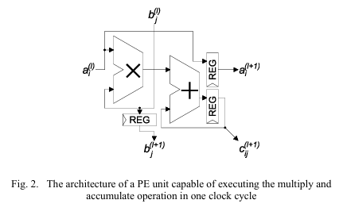
Architecture of PE
Reference - https://ieeexplore.ieee.org/document/10308496

Slide 9
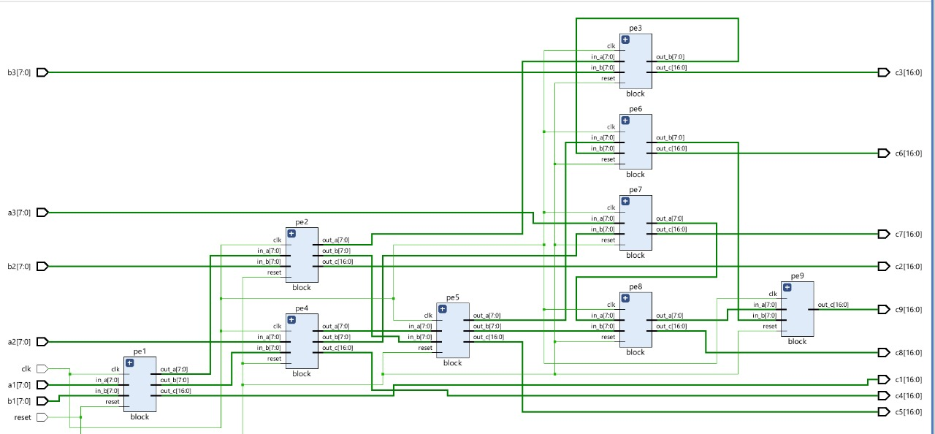
Block Diagram

Slide 10
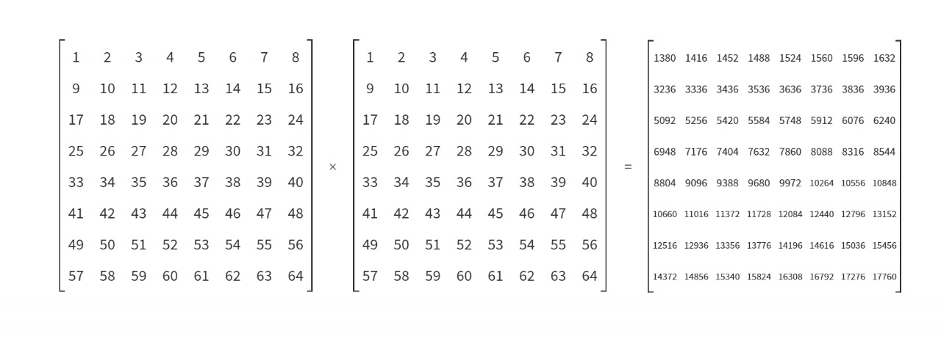
Input and Output Matrices

Slide 11
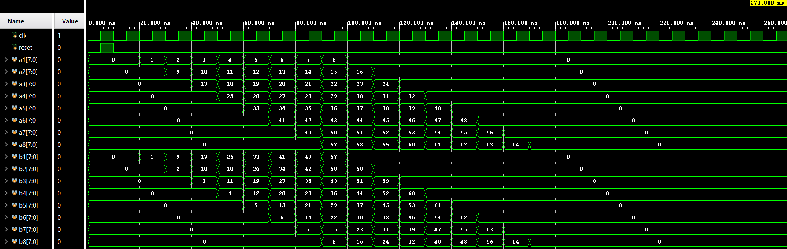
Simulation Results

Slide 12
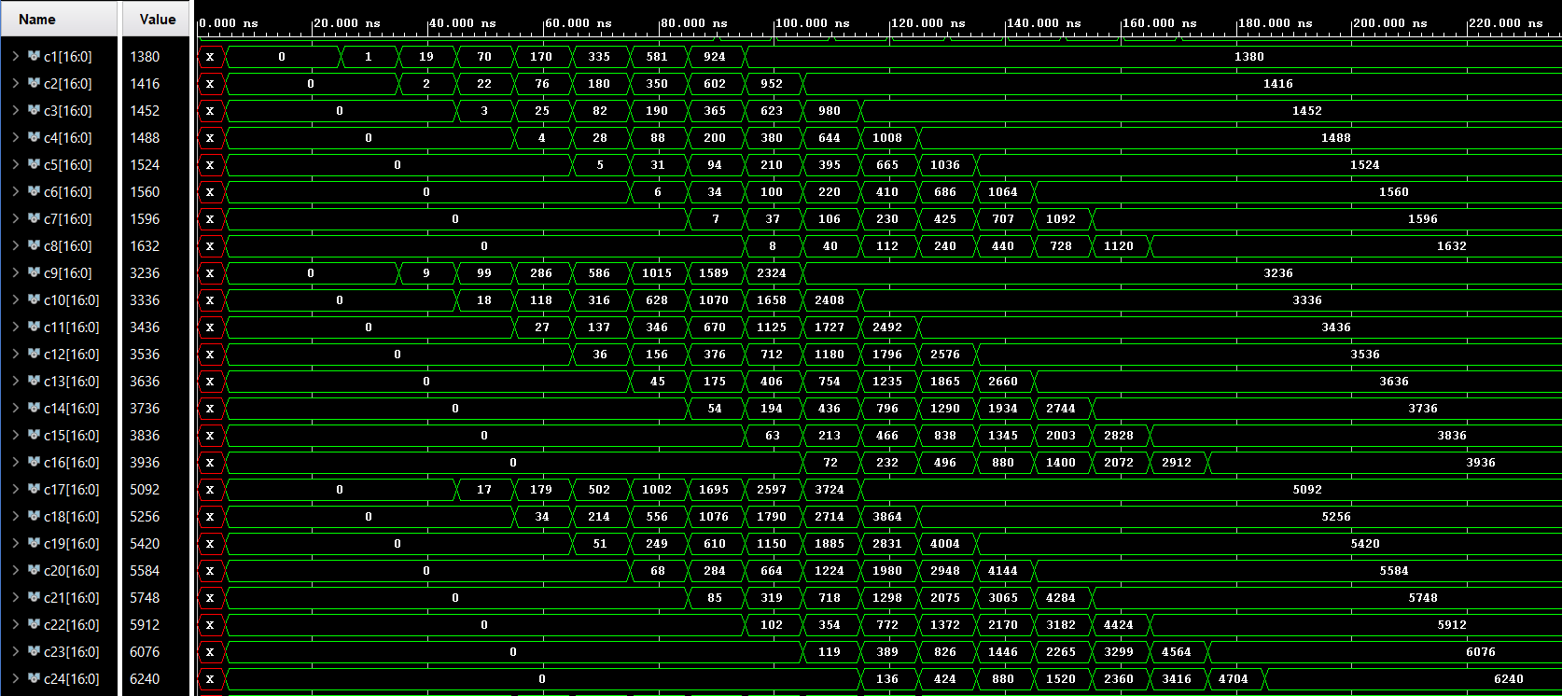

Slide 13
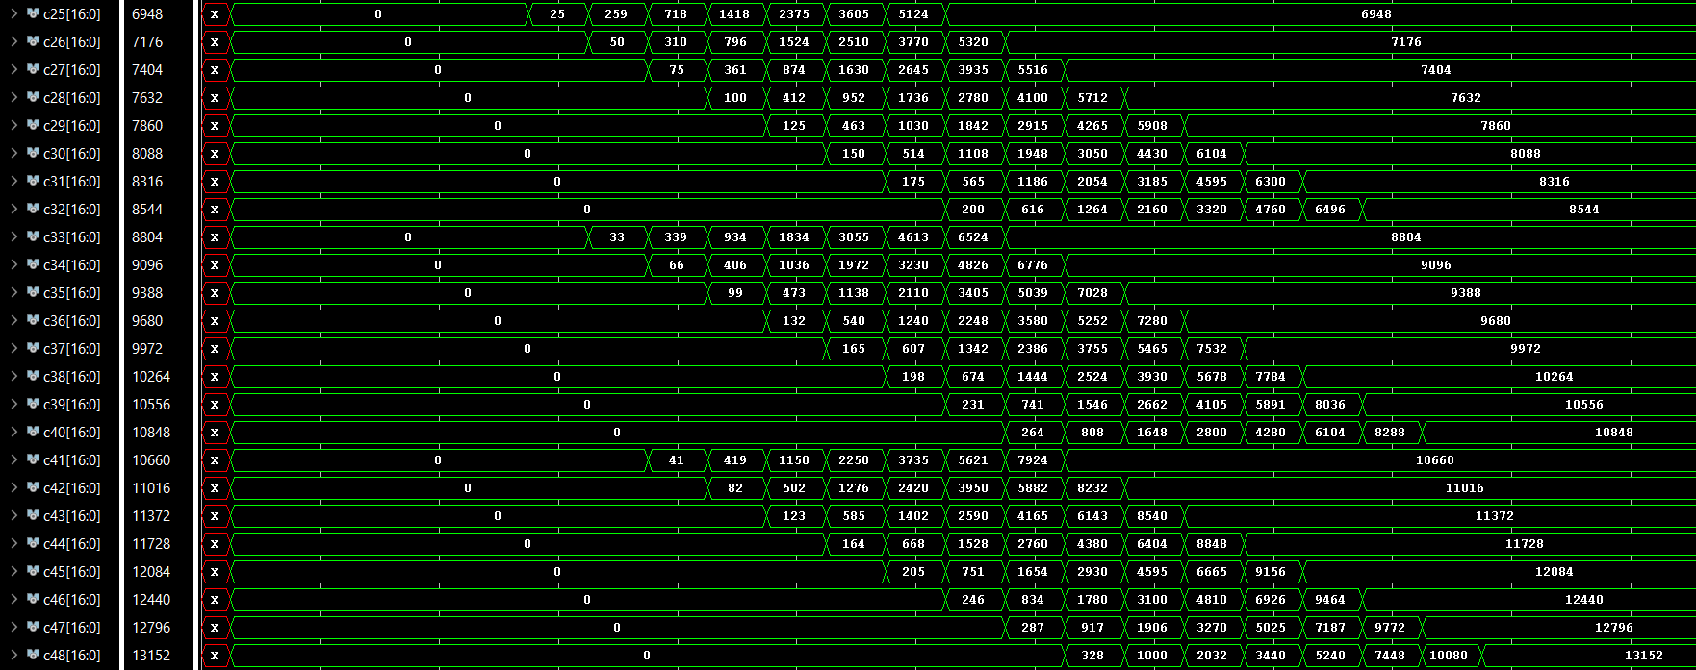

Slide 14
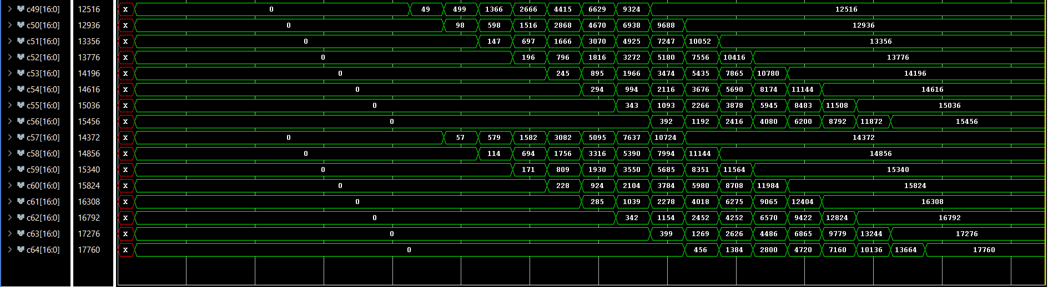

Slide 15
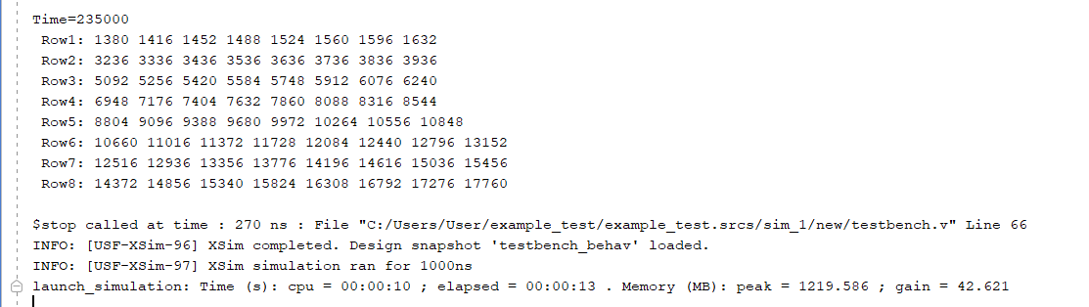

Slide 16


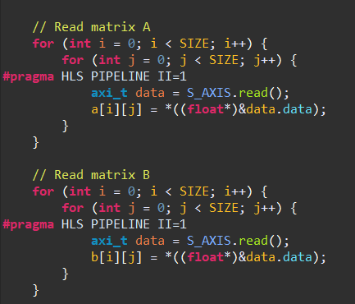
Code logic used in Vitis

Slide 17
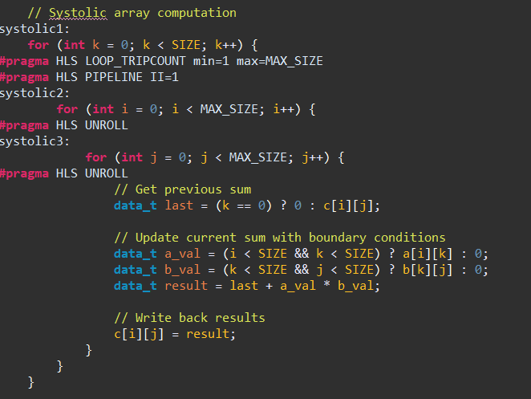
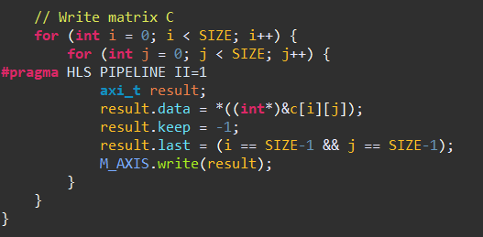

Slide 18
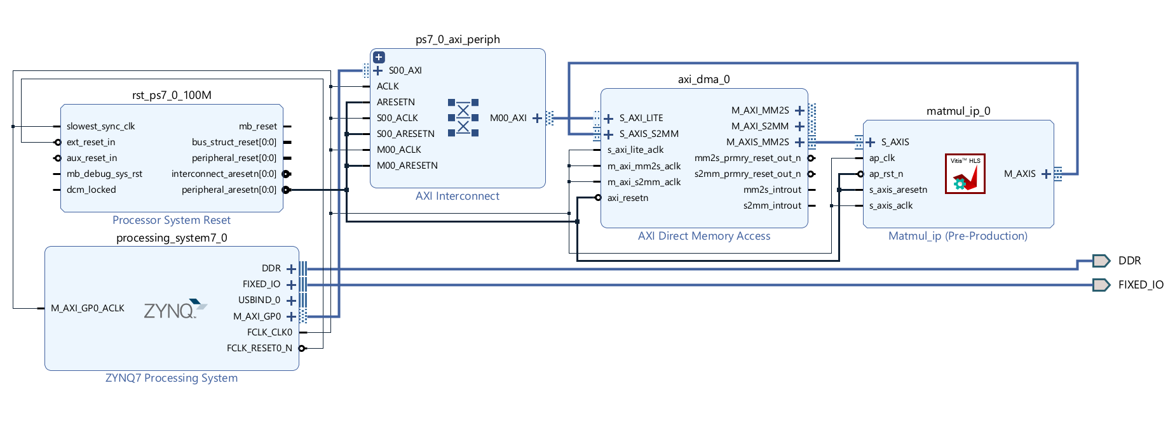
Block Design using custom IP made in Vitis

Slide 19
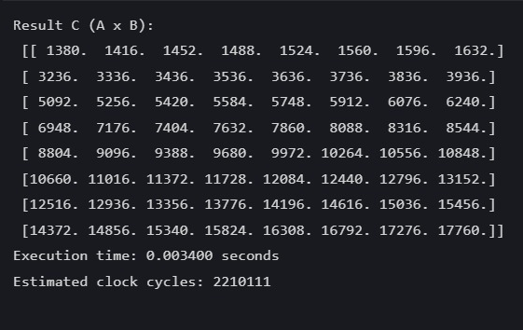
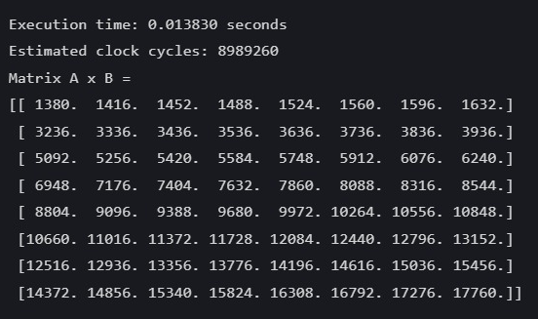
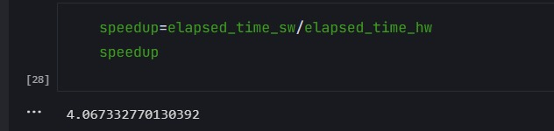
Hardware Simulation Software Simulation

Slide 20
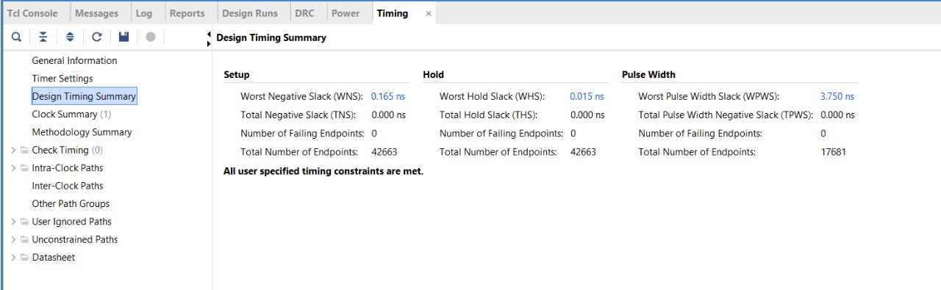
Design Timing Summary

Slide 21
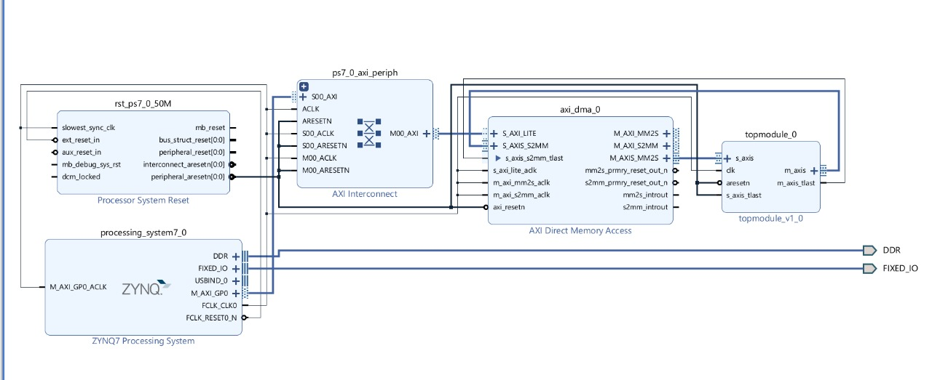
Axistream block design

Slide 22
THANK YOU!

